Slide 1
Meeting 29

Slide 2
Tasks
Fit occurrence model with different threshold
Fit amount model with re-arranged likelihood function
Re run the optimiser with set.seed()
Think about what to do next with the pilot study

Slide 3
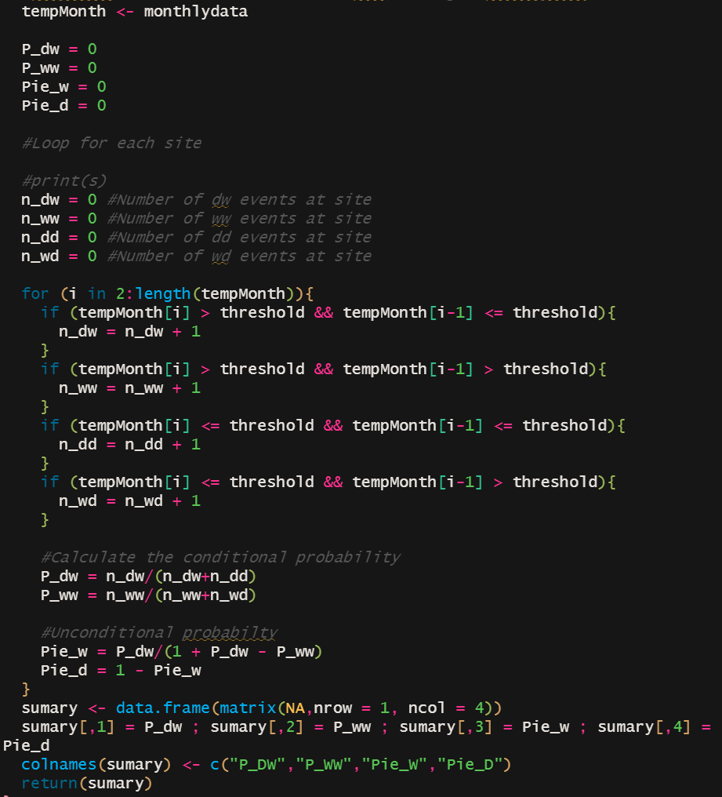
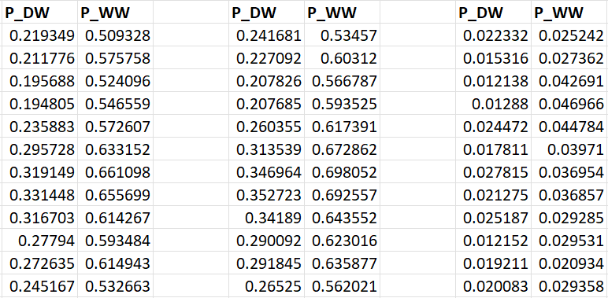
Occurrence model
Threshold = 0.1
Threshold = 0
Difference

Slide 4
Occurrence model
Threshold = 0.1
Threshold = 0
Difference

Slide 5
Amount model
For shape and scale
Same result
ƅ
1/ƅ
For shape and rate

